Slide 1

Minor Project
2021-22
Early and Accurate disease detection and diagnosis system
Group 18
Rahul Pamnani (9919102059)
Pranav Pandey (9919102049)
Harsh Kumar Mahour (9919102051)
Mentor
Dr. Bhartendu Chaturvedi

Slide 2
Table of Contents
Introduction
Literature Survey
Methodology
Results
Conclusion and Future Scope
References

Slide 3
Introduction
01
The COVID-19 epidemic, in which millions of people suffer, has affected the whole world in a short time. This virus, which has a high rate of transmission, directly affects the respiratory system of people. While symptoms such as difficulty in breathing, cough, and fever are common, hospitalization and fatal consequences can be seen in progressive situations.
02
The early detection of COVID-19 is a challenging task due to its deadly spreading nature and existing fear in the minds of people. Speech-based detection can be one of the safest tools for this purpose as the voice of the suspect can be easily recorded

Slide 4
Literature Survey
Vishnu Vandana Kolisetty et. al. [1]
This paper explains that the big data revolution is changing how it works and thinks, by facilitating improvements in vision and decision- making. This research paper provides strong pillars for the idea of analyzing the data and the significance of machine learning for data analysis in the particularly big data domain, which is just a reference to a vast collection of data and how reliable it is.
Ian McLoughlin et. al. [2]
This research paper motivated us to CNN model for audio processing and tells us about the robust nature of the CNN model in audio processing - motivated by the inherent image-like nature of the spectrogram representation – and encouraged by recently reported good CNN performance.

Slide 5
Charles Bales et. al. [3]
It has been explained that since cough is an essential symptom of many respiratory infections, an automated system to screen for respiratory diseases based on raw cough data would have a multitude of beneficial research and medical applications. From this research paper, it is concluded that the approach uses cough audio and converts it to Mel-spectrograms for both detection and diagnosis.
Emre C et. al. [4] have
It has made evident in this paper that Convolutional neural networks (CNN) can extract higher-level features that are invariant to local spectral. Recurrent neural networks (RNNs) are useful in learning the long-term temporal context in the audio signals. CNN’s and RNNs as classifiers have recently shown improved performances over established methods in various sound recognition tasks.

Slide 6
P. von Platen et. al. [5]
ANN AMs like time-delayed or recurrent neural networks have shown to be more effective with more power. It can effectively use a much longer data stream span than DNN 23.02. Input span plays an essential role in acoustic modelling CSV. This research paper concludes that by implementing various data augmentation methods by padding and changing the gain of our spectrogram, the results of our model can be highly improved.
Roy Rudolf Huizen et. al. [6]
Mainly focuses on improving the accuracy of noise audio recordings. High-quality audio recording, extraction using the Mel frequency cepstral coefficients (MFCC) method produces high accuracy. While the low-quality is because of noise, the accuracy is low.

Slide 7
Quan Zhou et. al. [7]
It has explained that with the outbreak of COVID-19, it is necessary to distinguish the sound of coughing. This paper provides the soul working building model and evidence for us for using the CNN model for classifying cough into different domains based on Mel-spectrogram from the experiment conduct
Coronavirus disease 2019 (COVID-19) Situation Report – 51 [8]
Represents a report from WORLD HEALTH ORGANISATION (WHO) highlighting the severity and worse conditions that the people have to dealt with. Showing a brief report of the total cases as of 11 march 2020. How it spreads and overall assessment of COVID-19 and categorized it as a pandemic.

Slide 8
Methodology
Library Used | Implementation
OpenCv | It is used to speed up the use of real-time machine recognition of images, objects, and video processing applications.
Numpy | Used for scientific computing in the code
Librosa | All of the audio pre-processing was done using this library
Keras | Keras is based on a minimal structure that provides a clean and easy way to create deep learning models based on TensorFlow
Pandas | Used in classification and merging datasets
TensorFlow | It is a symbolic math library that uses dataflow and differentiable programming to perform various tasks focused on the training and inference of deep neural networks
Matplotlib | Alternative to MATLAB for data visualisation and graphing

Slide 9
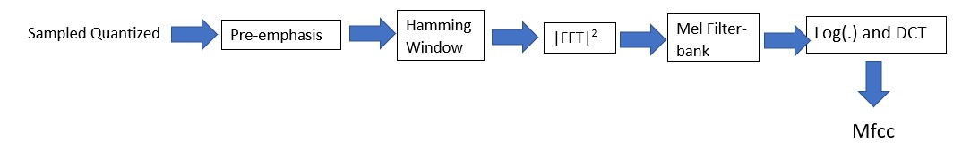
First the audio features are extracted from the sample database
An audio recognition feature called MFCC or Mel-Frequency Cepstral Coefficients is used for the audio preprocessing.
The Librosa library contains all the required functions to obtain MFCCs of the cough samples.
A flowchart depicting the entire process of obtaining MFCCs is given below :
Along with some other 2D features such as Spectral Centroid, Spectral Bandwidth, Spectral Roll-off, Zero Crossing Rate (ZCR)+energy.

Slide 10
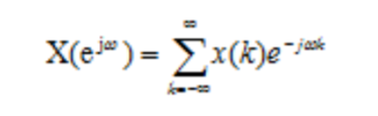
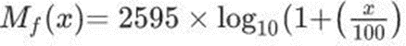
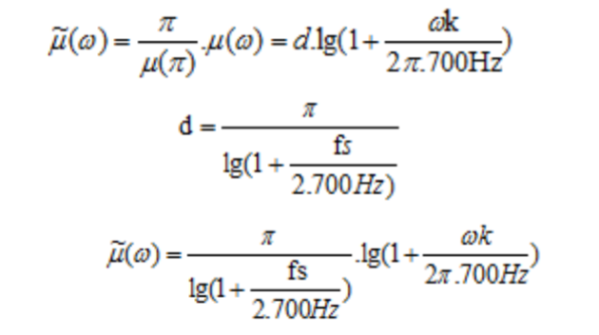
Fourier Transform of Signal is given by:
Mel-Frequency Scaling for each frame is given by the formula:
The formula for Discrete Cosine Transform is given by:

Slide 11
Now, we have the steps regarding the training and augmentation of data using CRNN:
This data is splitted into training and testing data in order to feed in testing and training function.
For the training part:
All the extracted features go through a series of 7 convoluting layers with the no. of filters ranging from 64 to 512 in seven different steps.
Then the output from this is fed to the recurrent neural network function passing through the concoluting layer recurrently.
This data is then augmented (data augmentation is done just for balancing the dataset) using the following techniques:
Time shift
Stretching the sound
Changing chain
Adding background noise
This data is then tested and model is obtained.

Slide 12
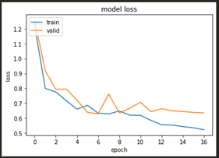
Results
Our model has some losses in its test data due to the quality of recorded audio as it assumes to receive cough sounds for a time window of 5 seconds and any disturbance and quiet time hinders its data between the valid dataset one and the trainable dataset
The Model Loss attained due to the quality of the audio samples is given below in the graph :

Slide 13
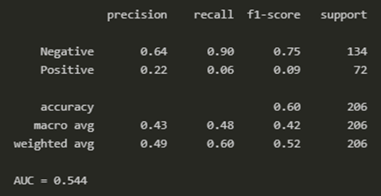
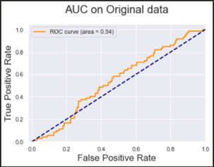
Predictions based on our original data are coming out to be 64% in case of predicting negative cases and 22% in case of predicting positive test cases. An overall accuracy with F1-score is calculated as 60%.
The AUC(area under the curve)/ROC(region of convergence) between FPR(false positive rate) & TPR(true positive rate) to be 54.4%
Predictions based on Original Data

Slide 14
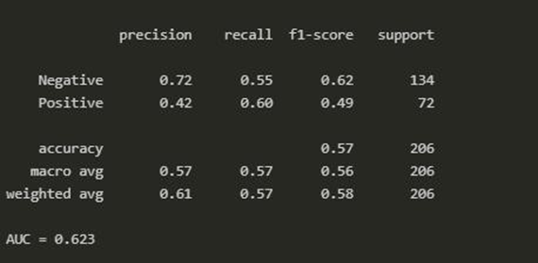
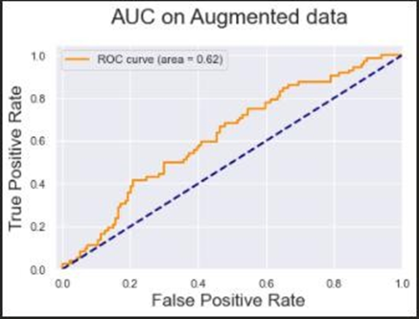
Predictions based on Augmented Data
Predictions based on our augmented data are coming out to be 72% in case of predicting negative cases and 42% in case of predicting positive test cases. An overall accuracy with F1-score is calculated as 57%
The AUC (area under the curve)/ROC (region of convergence) between FPR (false positive rate) & TPR (true positive rate) to be 62.3%

Slide 15
Conclusion & Future Scope
The detection of COVID-19 using speech signals can serve as an important cost-effective tool as it does not involve any complicated medical test. This approach can easily diagnose the preliminary condition of a patient even without visiting a hospital and without the help of any medical staff as it serves as an automatic detection tool
However, the classification accuracy can further be improved by using deep learning-based techniques. The attributes given in the dataset are breath, cough, and voiced vowel sounds. Moreover, the analysis can be extended to study the phonetic relevance and identification of phonemic grouping of speech-based COVID-19 detection
It has also been observed that existing CRNN algorithms work with better efficiency as we provide more and more data to our model as the machine trains itself for diverse situations and samples and improves its precision so adding/combining more data to our existing data will also improve its precision and accuracy.

Slide 16



Slide 17



Slide 18
References
[1] Vishnu Vandana Kolisetty and Dharmendra Singh Rajput, “A REVIEW ON THE SIGNIFICANCE OF MACHINE LEARNING FOR DATA ANALYSIS IN BIG DATA", (Received: 2-Aug.-2019, Revised: 26-Oct.-2019, Accepted: 16-Nov.-2019).
[2] Haomin Zhang, Ian McLoughlin, Yan Song, “ROBUST SOUND EVENT RECOGNITION USING CONVOLUTIONAL NEURAL NETWORKS”, 19-24 April, 2015.
[3] Charles Bales, Muhammad Nabeel, Charles N. John, Usama Masood, Haneya N. Qureshi, Hasan Farooq, Iryna Posokhov and Ali Imran, “Can Machine Learning Be Used to Recognize and Diagnose Coughs?”, 2020.
[4] Emre C¸ akır, Giambattista Parascandolo, Toni Heittola, Heikki Huttunen, and Tuomas Virtanen, “Convolutional Recurrent Neural Networks for Polyphonic Sound Event Detection”, 21 Feb, 2017.
[5] P. von Platen, C. Zhang, P. C. Woodland, “Multi-Span Acoustic Modelling using Raw Waveform Signals”, 3 Oct, 2019.
[6] Roy Rudolf Huizen, Florentina Tatrin Kurniati, “Feature extraction with Mel scale separation method on noise audio recordings”, Sep 15, 2021.
[7] Quan Zhou, Jianhua Shan, Wenlong Ding, Chengyin Wang, Shi Yuan, Fuchun Sun, Haiyuan Liand Bin Fang, “Cough Recognition Based on Mel-Spectrogram and Convolutional Neural Network”, Shanghai University, China, 07 May, 2021.
[8] World Health Organization. Coronavirus Disease 2019 (COVID-19) Situation Report; Technical Report March; World Health Organization: Geneva, Switzerland, 2020.

Slide 19
THANK YOU

